Slide 1

2026
Skyline Capital Partners
Skyline Capital Partners
Strategic Investment Analysis
Market Selection & Unit Mix Optimization for Class B Assets
Karina Hsu | Investment Analyst
March 5th, 2026

Slide 2

PPT模板 http://www.1ppt.com/moban/
Executive
Summary
Investment Recommendation
Key Decision Drivers
New Hope demonstrates a structural advantage in expense management (lowest OER) and capital appreciation (highest Equity Multiple).
While Fairview offers slightly better occupancy, the return premium in New Hope significantly outweighs the marginal leasing risk.
We recommend New Hope as the primary market for Class B expansion. Our data-driven analysis indicates New Hope offers the highest risk-adjusted returns among the three target cities.
• Highest IRR: 7.30% vs. 4.76% (Fairview).
• Best Growth: 6.0% NOI CAGR (Historical).
• Asset Strategy: Optimize for Studios to maximize NPV per
Sq. Ft. efficiency ($411).
This represents the Net Present Value generated per square foot of floor space (Total Unit NPV / Unit Size).

Slide 3

01
Market Selection
Comparative historical analysis of Fairview, New Hope, and Springfield to identify the strongest development opportunity.
Notes:
模板来自于：第一PPT https://www.1ppt.com/

Slide 4
Market Scorecard: Class B Performance
New Hope consistently leads return outcomes across both operational income growth and investor capital appreciation.
A materially higher IRR suggests stronger cash flow + value creation, providing more buffer against downside scenarios.
A
Stronger NOI growth supports higher exit value (cap-rate based valuation) and improves resilience against rising expenses or soft demand.
B
New Hope Leads Capital Appreciation: Highest Average Equity Multiple (1.08x) and Equity Growth (7.94%). This confirms that New Hope is not just an income play (NOI), but also the strongest capital appreciation play.
C

Slide 5


Profitability Headwinds: Expense Analysis
Operating Efficiency Insight
While Fairview shows slightly better occupancy (lower vacancy), the vacancy gap is small (0.53 pp range) and does not offset New Hope’s return advantage.
Market | Avg Vacancy (%) | Avg OER (%)
New Hope | 10.01 | 50.26
Springfield | 10.25 | 52.05
Fairview | 9.72 | 57.56
Operating Expense Ratio (OER) is a direct headwind to profitability. New Hope's structurally lower OER (50.26%) supports stronger cash flow conversion.
In contrast, Fairview suffers from a significant expense drag (57.56%), eroding nearly 7.5% more margin than New Hope, which limits its IRR potential despite high occupancy.

Slide 6
Market Specific Risk Factors
Risk is evaluated using vacancy (demand risk) and OER (cost risk), then weighed against return outcomes (NOI CAGR, IRR).
New Hope
Risk: Vacancy 10.01% is slightly above Fairview (+0.29 pp) → modest lease-up risk.
Impact: Lower effective rent can slow NOI realization early in the hold.
Mitigation: Underwrite +1 pp vacancy stress and fund a lease-up/marketing reserve.
Fairview
Risk: High cost structure - OER 57.56% (+7.30 pp vs New Hope).
Impact: Expense drag compresses NOI and limits IRR upside.
Mitigation/Condition: Invest only with a clear cost-down plan (ops + capex) and contingency reserves.
Springfield
Risk: Growth stagnation - NOI CAGR 1.0% with IRR 4.03%.
Impact: Weak reward for similar vacancy levels; limited valuation expansion.
Decision: Deprioritize unless a specific catalyst/value-add thesis is identified.
Demand/Lease-up Risk
Cost/Margin Risk
Growth/Upside Risk

Slide 7
Strategic Trade-offs & Risk-Adjusted Returns
The Yield-Stability Trade-off
Across markets, New Hope offers the highest return profile, while Fairview is marginally more stable on occupancy. The stability gap is small, but the return gap is meaningful.
2.54%
IRR Alpha vs. Fairview
New Hope (Selected)
We trade 0.29 pp occupancy stability (vacancy proxy) for +2.54 pp IRR alpha vs. Fairview - an attractive risk-adjusted exchange aligned with Skyline’s mandate.
IRR: 7.30% vs 4.76%
Vacancy: 10.01% vs 9.72%
Risk Action (Defensive Growth)
Underwrite +1 pp vacancy stress, fund a lease-up/marketing reserve, and prioritize tenant retention to protect NOI while capturing growth.

Slide 8
02
Simulation
Based Unit Mix Optimization

Slide 9

Objective & Decision Framing
Strategic Goal
Maximize the Net Present Value (NPV) for an 85-unit Class B development in the New Hope market.
Primary Decision
Determine the optimal allocation between Studio and 1-Bedroom units while satisfying space and market demand constraints.
Model Workflow
Memo Parameter Inputs
Demand & Cap Simulation
Pro Forma Cost Model
10-Year Cash Flow Projections
NPV-Maximizing Best Mix

Slide 10
Key Constraints & Cost Structure
A) Space & Unit Constraints
Total Units | 85
Total Floor Space | <= 80,000 sq ft
Studio Size | 800 sq ft
1-Bedroom Size | 1,200 sq ft
B) Operating Cost Assumptions
Fixed Costs | $320,000 / year
Studio Var. Cost | $720 / unit / month
1-BR Var. Cost | $1,000 / unit / month
Discount Rate | 10.0%
-> 800S + 1,200B < = 80,000

Slide 11
Demand Model: Market Absorption Risk
Rent Level | Market Cap (Studios) | Market Cap (1-Bedrooms)
Less than $1,500 | 60 | 75
$1,500 - $1,800 | 55 | 70
$1,800 - $2,100 | 48 | 65
$2,200 - $2,500 | 40 | 57
$2,500 - $2,800 | 30 | 48
$2,800 - $3,100 | 18 | 35
Risk-Aware Absorption
To avoid unrealistic lease-up, the model enforces market capacity limits: higher rents reduce maximum leasable units.
Why it matters
This prevents choosing a mix that only
works theoretically but fails in reality because the market cannot support that specific unit density at premium rents.

Slide 12
Optimal Unit Mix: The Winning Solution
55 / 30
Strategy Review
Floor Space Utilization: 100% (Exactly 80,000 sq ft). The space constraint is "binding.”
Unit Density: Maximizing Studio count captures higher rent-per-sqft efficiency.
Absorption Buffer: The 30-unit 1-BR allocation remains well within the 48-unit market cap for its rent tier ($2,565).
Takeaway: The optimizer fully utilizes floor space to maximize value under combined demand and cost constraints.
Studio / 1-Bedroom Allocation
$14.12M
Estimated Project NPV

Slide 13
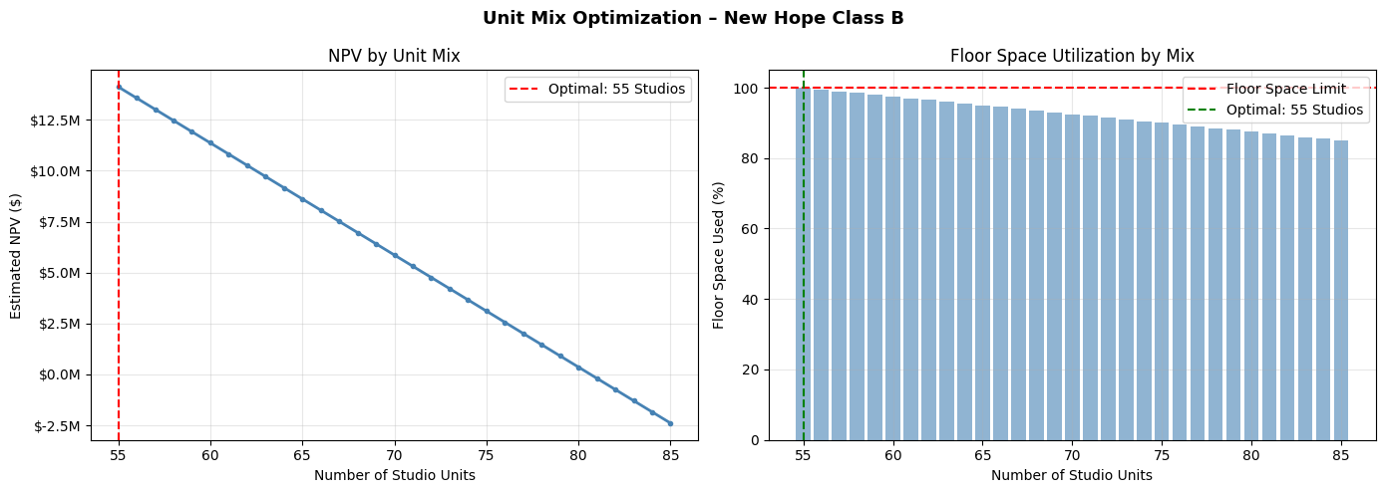
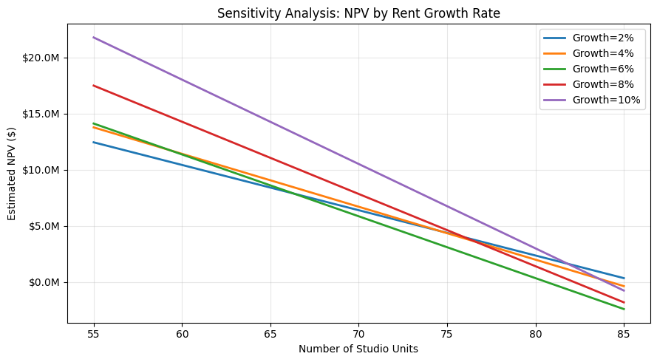
Validation: NPV Peak & Growth Resilience
NPV by Unit Mix
Rent Growth Sensitivity
Our simulation shows a clear Peak at 55 Studios. Total project value declines as the mix shifts further toward Studios or 1-BRs due to either floor space wastage or market cap friction.
Across growth scenarios (2%-10%), the optimal mix stays 55/30. This confirms the structural robustness of the recommendation against market volatility.

Slide 14
Downside Stress Test: Strategic Resilience
Scenario | Rent Growth | Cost Increase | NPV
Base Case | 6% | 0% | $14,115,842
Mild Downside | 5% | 5% | $11,723,171
Downside Case | 4% | 10% | $12,039,539
Severe Case | 3% | 15% | $11,408,646
Even under "Severe" conditions (Rent growth halved to 3%, operating costs +15%, and higher structural vacancy), the 55/30 mix maintains a strong positive NPV of over $11.4M. The project is structurally sound.
The NPV slightly recovers in the 4% growth scenario compared to the 5% scenario. Why? Slower rent growth keeps the units in a more affordable rent tier for longer, avoiding Skyline's strict Market Cap limits. This proves that high occupancy can offset lower rent premiums.
Key risk insight: demand caps (absorption) can dominate rent premiums; maximizing ‘priced-to-lease’ occupancy protects value.
Proceed confidently with the 55/30 mix. However, to mitigate the impact of rising variable costs (Cost +15% risk), we recommend securing fixed-rate vendor contracts for maintenance and holding a conservative lease-up cash reserve in Years 1-2.

Slide 15
Exit Cap Rate Risk (Valuation Sensitivity)
Scenario | Exit Cap Rate | Estimated NPV | Impact
Base Case | 6% | $14,115,842 | -
Stress (+50 bps) | 5% | $13,519,174 | - $596,668
Severe (+100 bps) | 4% | $13,007,745 | - $1,108097
Strategic Resilience: Even under a severe +100 bps expansion in the exit cap rate (reflecting a softer future buyer market), the 55/30 optimal mix maintains a robust $13.01M NPV.
Conclusion: Our returns are anchored by strong operational cash flows, not just optimistic exit valuations. The project is highly defensible.

Slide 16
2026
Skyline Capital Partners
Skyline Capital Partners
Strategic Investment Analysis
Market Selection & Unit Mix Optimization for Class B Assets
Karina Hsu | Investment Analyst
March 5th, 2026
Gmail: karina.hsu2000@gmail.com

